Slide 1
Photo Album
by Horace Butler

Slide 2
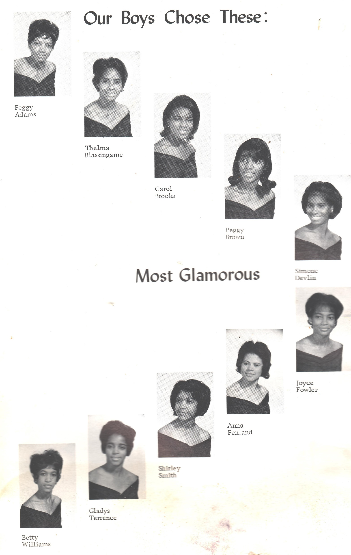

Slide 3
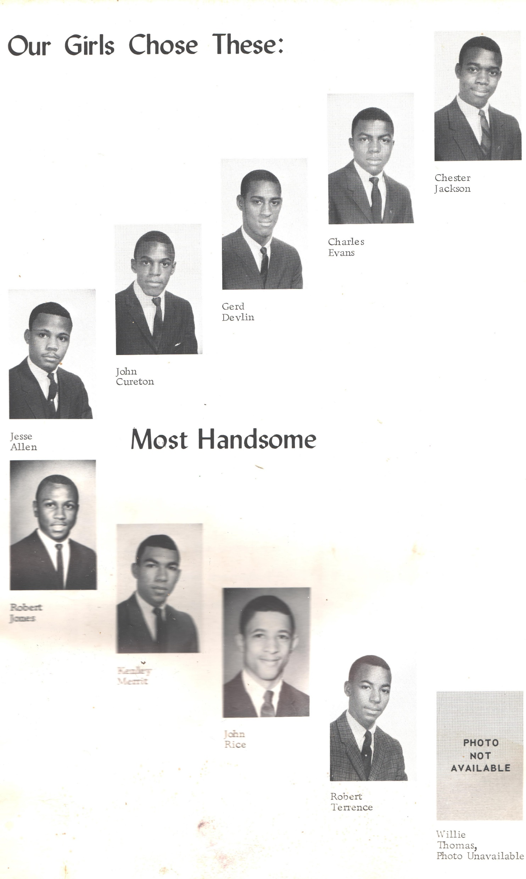

Slide 4
